Slide 1
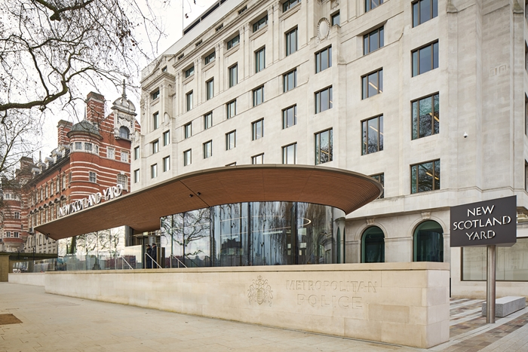
Met Police VAWG Action Plan
What The Met is doing to bear down on violence against women and girls in London
November 2021
January 2020

Slide 2
Met VAWG Action Plan
What we are doing to help make women and girls safer and feel safer in London
Met Commissioner Cressida Dick said:
“Tackling violence remains our top operational priority, including crimes that disproportionately affect women and girls, such as domestic abuse and sexual violence. Male violence against women and girls has a profound and long-lasting impact on those directly affected, shattering the lives of victims, their families and those closest to them. Such violence also affects local communities and impacts on the public’s confidence in the safety of their area, and in the effectiveness of their police service.
“We want the public’s views and will update the plan following this engagement.
“We are ambitious for change, and want the best results that will improve people’s lives – that means listening and acting on recommendations and findings from independent reviews, as well as learning from other police forces’ achievements, the achievements of other organisations and academia. An important part of our approach is to invite women and girls to tell us what they think needs to change, and to keep talking to us about what more we can do to create safe environments.”

Slide 3
Met VAWG Action Plan – setting the context
What we are doing to help make women and girls safer and feel safer in London
The term ‘violence against women and girls’ refers to acts of violence or abuse that disproportionately affect women and girls. Crimes and behaviour covered by this term include rape and other sexual offences, domestic abuse, stalking, harmful practices (including female genital mutilation and forced marriage) as well as many others, including offences committed online.
National statistics outline the scale of the issue:
7.3% of women in England and Wales have experienced domestic abuse in the past 12 months
15.2% of all recorded crime in England and Wales and 35.5% of all recorded violence against the person crimes is domestic abuse-related
25% of women are affected by domestic violence in their lifetime, with estimates suggesting well over a million women suffer from domestic abuse each year
Two women are killed every week in England and Wales by a current or former partner.
A recent report by UN Women UK found that 97 per cent of women aged 18-24 have been sexually harassed, with 96 per cent not reporting those situations because of their belief that it would not change anything.
Women should feel confident about reporting, and that their report will be taken seriously by the police. It is clear we have more to do.

Slide 4
Met VAWG Action Plan – key objectives
What we are doing to help make women and girls safer and feel safer in London
We want to:
increase the number of perpetrators brought to justice for violence against women and girls;
improve processes and victim care across the criminal justice system to reduce the number of cases failing;
reduce repeat victimisation of women and girls;
increase women’s confidence in the police so as to improve the reporting of crimes which disproportionately affect women and girls within London;
see an increase in reporting to police, but a decrease in women being abused, i.e. the proportion of women experiencing these crimes in each year (measured through reporting in the Crime Survey in England and Wales); and
intensify work to tackle sexual misconduct and domestic violence by officers and staff; improve the confidence of people to tell us about sexual misconduct and domestic abuse committed by officers and staff; improve our support to victims and our investigations; and reach outcomes that are understood and build confidence.

Slide 5
Met VAWG Action Plan – key themes and areas of focus
What we are doing to help make women and girls safer and feel safer in London
There are four themes within this plan. Much work is already happening. Our future work will build on that work and also will focus on these areas:
Protecting women and girls in public spaces, at home and online
Increasing policing presence in the public space
Preventing night time violence
Increasing officer training and capability to respond to violence against women
Working with our partners and with women to improve prevention and victim care
Engaging with women and girls and responding to their feedback
Increasing prevention
Improving victim care and support with partners
Bringing offenders to justice and improving criminal justice outcomes for victims
Targeting and managing offenders
Improving response and investigation
Improving Met culture and professional standards
Upholding the highest professional standards including through our Rebuilding Trust plan
Improving Met culture including through the review being led by Baroness Casey of Blackstock
Furthering gender representation across commands and at all levels

Slide 6
Met VAWG Action Plan – your feedback
What we are doing to help make women and girls safer and feel safer in London
You can find the action plan here alongside our Rebuilding Trust plan - https://www.met.police.uk/police-forces/metropolitan-police/areas/about-us/about-the-met/rebuilding-trust/
We want to hear feedback from communities and partners on this plan. You can to do this online at https://www.smartsurvey.co.uk/s/PublicFeedbackVAWG/
We want to hear views on the plan itself as well as comments on what else you think the Met should be doing.
We are also holding roundtables and conversations with partners in coming months so that Basic Command Units and other teams can hear from their local connections.
The feedback we receive will form an integral part of our final plan.

